Slide 1
SUPPORTING THE DEVELOPMENT OF ENVIRONMENTALLY SUSTAINABLE PSS BY MEANS OF THE ECODESIGN MATURITY MODEL
by
Daniela C. A. Pigosso and Tim C. McAloone
Presenting Author: Daniela C. A. Pigosso
TECHNICAL UNIVERSITY OF DENMARK
KGS. LYNGBY, DENMARK
danpi@dtu.dk

Slide 2
Introduction
Shift to PSS is mainly driven by business motivations
PSS potential for increased environmental performance is high, but PSS is not intrinsically sustainable!
PSS design is a key factor for the development of sustainable PSS

Slide 3
Hypothesis
Implementation of ecodesign best practices into PSS development has the potential to increase PSS environmental performance, supporting the transition towards a more sustainable system

Slide 4
Research aim and methodology
Identify the best practices for PSS development
Literature Review: best practices for PSS development
Support the development of environmentally sustainable PSS
Categorization of best practices for PSS development
Propose their integration into the Ecodesign Maturity Model (EcoM2)
Correlation analysis of best practices and EcoM2

Slide 5
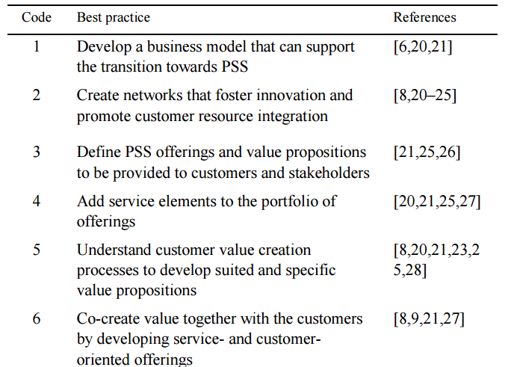
Best practices for PSS design
17 identified best practices (managerial activities required to develop PSS)

Slide 6
Best practices for PSS design
Wide range of considerations:
Only one practice clearly incorporates environmental dimension: #8 “Understand the life cycle of the offerings”
business models
establishment and management of complex networks
new service offerings and value propositions
value creation and co-creation processes
mapping and visualization
value-driven communication
customer interaction
customization strategies
tangible and intangible values
data collection

Slide 7
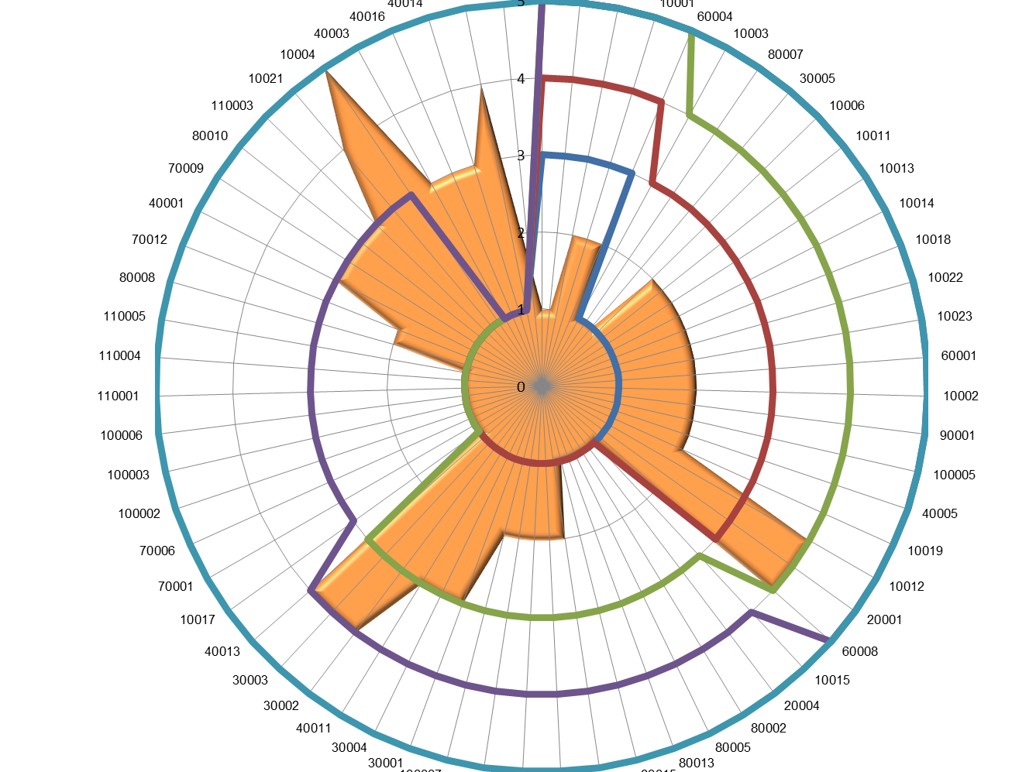
Ecodesign Maturity Model (EcoM2)
Framework to support ecodesign implementation
Step-by-step approach
Focus on process improvement
Companies: LEGO, Philips, Grundfos, Natura, Embraer…

Slide 8
EcoM2 for PSS
EcoM2 for PSS: support the development of environmentally sustainable PSS
1. Classification of the 17 best practices for PSS development
2. Modification/adaptation of the EcoM2 practices
EcoM2 evolution levels
From products to PSS
Development phases
EcoM2 for PSS model presents a total amount of 79 management practices

Slide 9
Main findings
#1
Importance of considering PSS in the early stages of the development process (13 out of the 17 identified practices)

Slide 10
Main findings
#2
Importance of close links with customers and stakeholders for value creation

Slide 11
Main findings
#3
Later development stages are similar for PSS and traditional product design

Slide 12
Main findings
#4
Launch and accompanying/monitoring seems to play a crucial role in ensuring PSS business success

Slide 13
Main findings
#5
Companies with a higher maturity on ecodesign will have the highest potential for the development of environmentally sustainable PSS

Slide 14
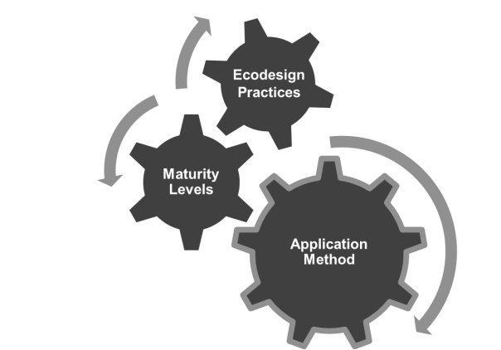
EcoM2 for PSS
Continuous Improvement
Planning of the improvement projects
Implementation of the projects
Assessment of the results
Strategic roadmap for implementation
Diagnosis of the current maturity profile
Definition of strategic goals for implementation

Slide 15
Final Remarks
EcoM2 for PSS supports managers to:
a) identify strengths and improvement opportunities
b) define the vision and to-be maturity profile
c) deploy a strategic roadmap
d) implement and measure performance

Slide 16
Future research
Build a comprehensive body of knowledge of PSS practices
Refinement and validation by experts
Test via action research and case studies

Slide 17
THANK YOU FOR YOUR ATTENTION!
Daniela C. A. Pigosso
TECHNICAL UNIVERSITY OF DENMARK
KGS. LYNGBY, DENMARK
danpi@dtu.dk

